Slide 1


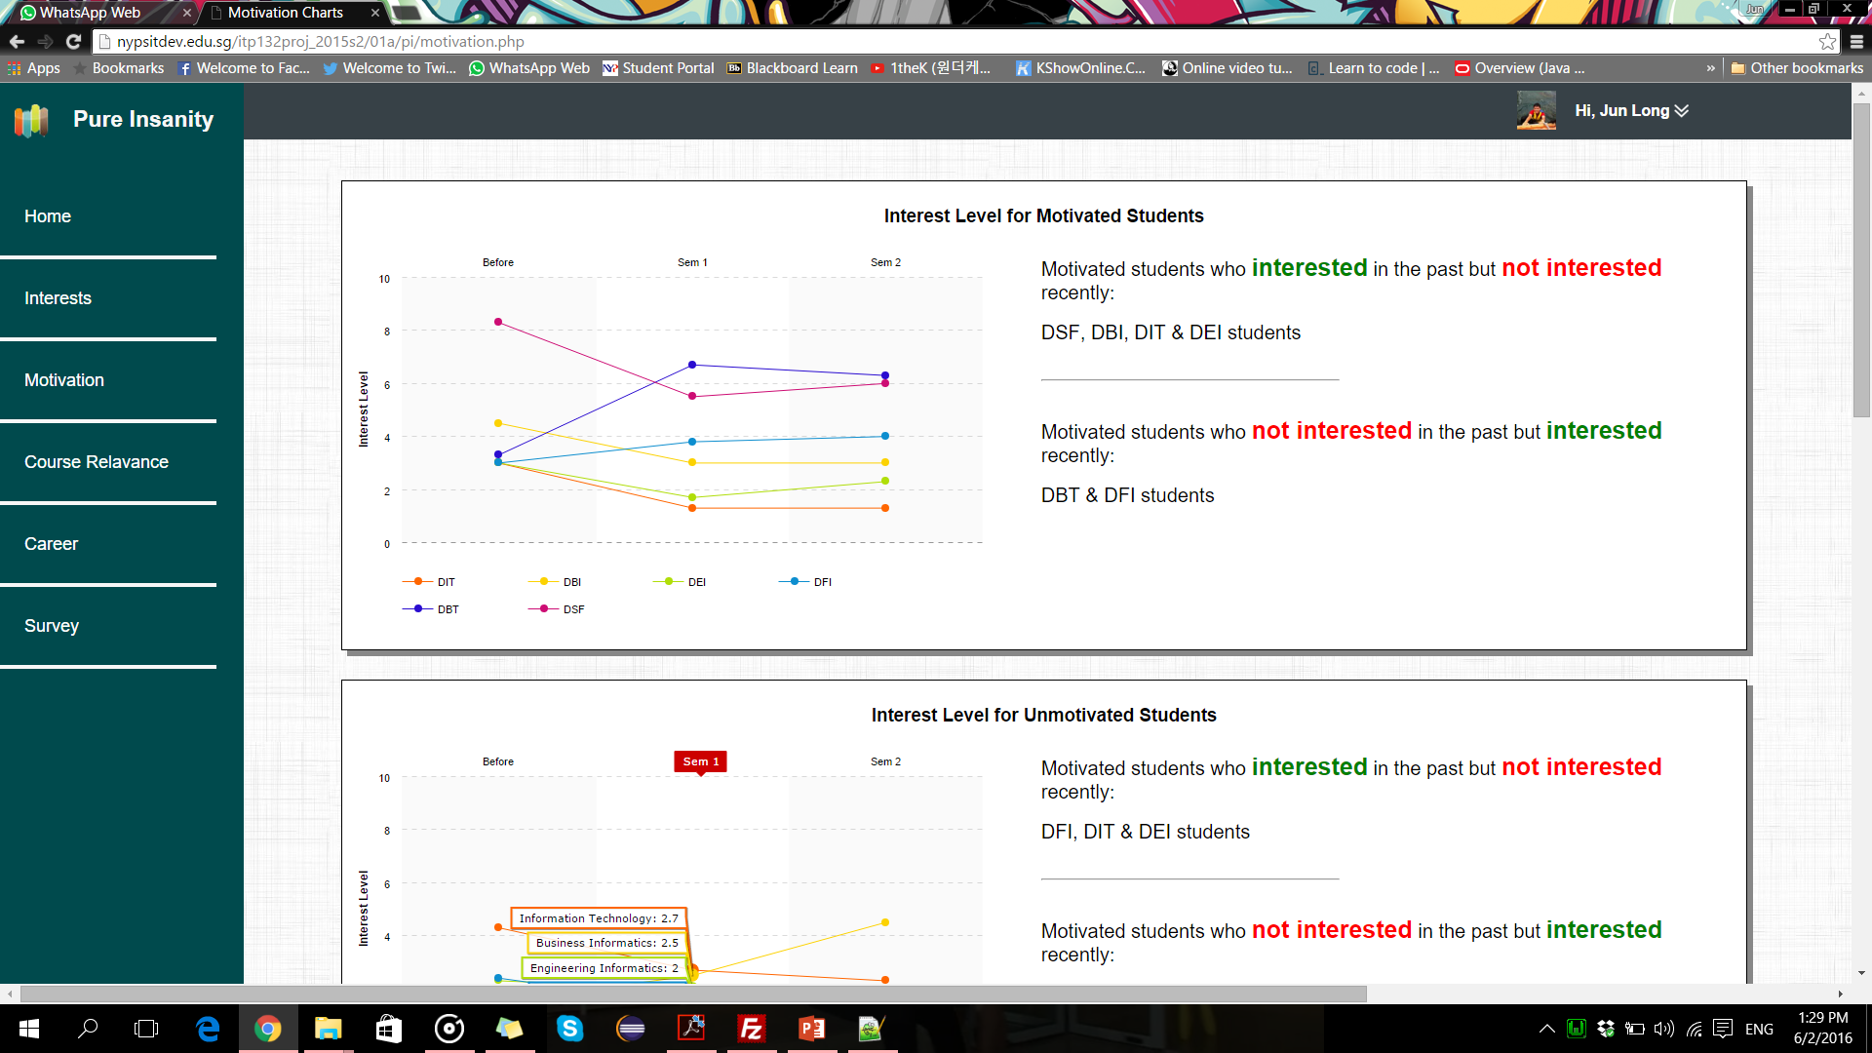
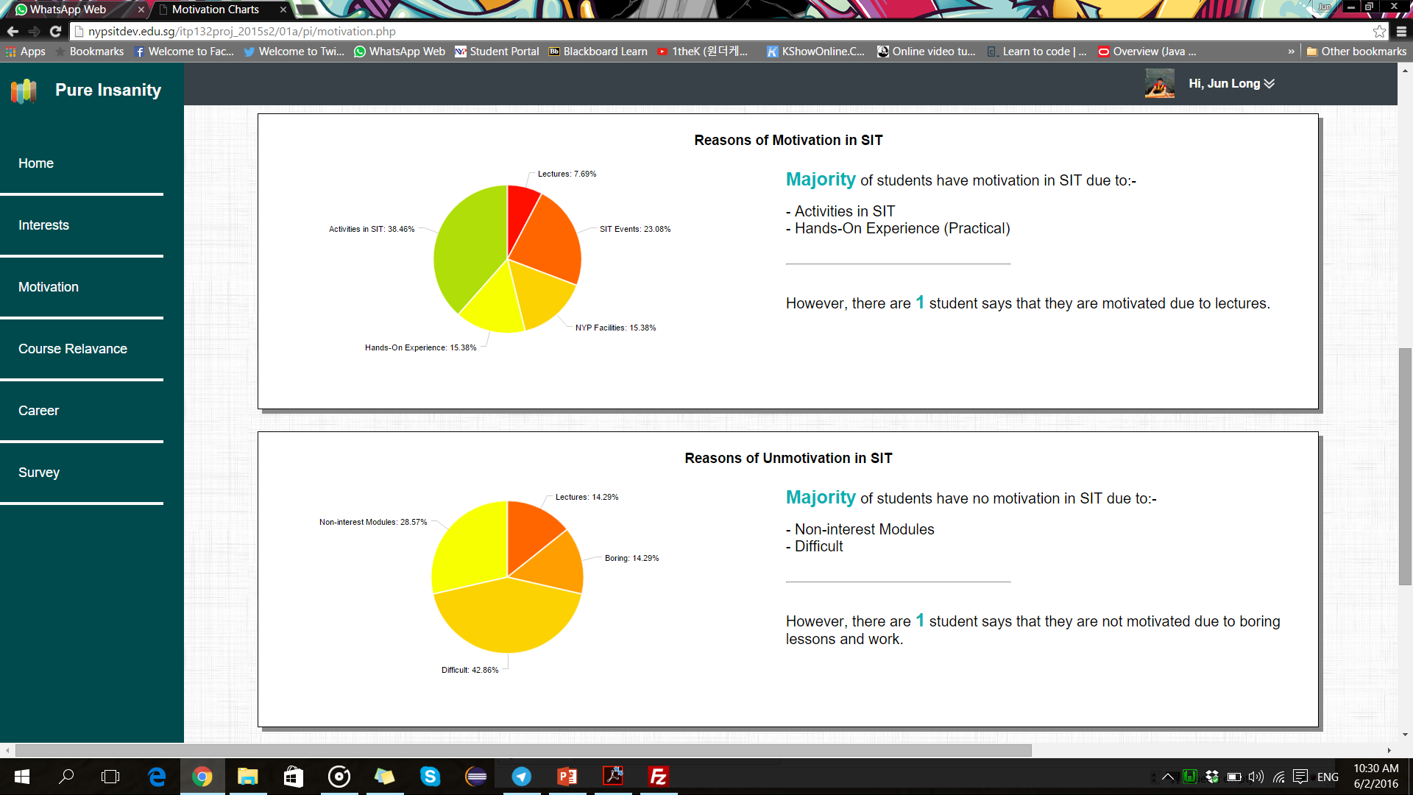
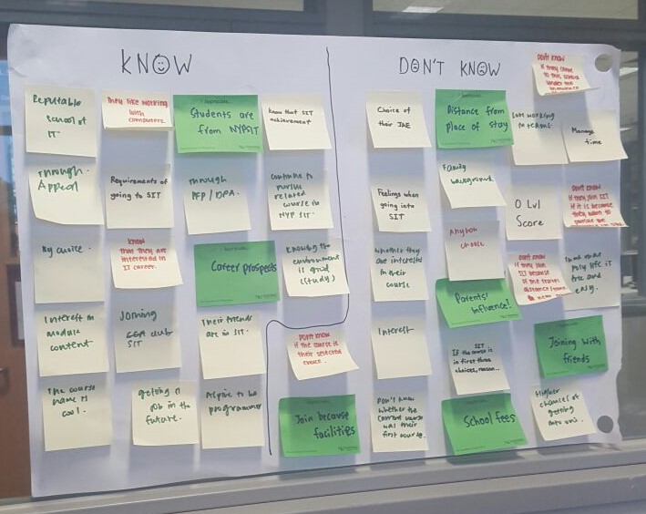
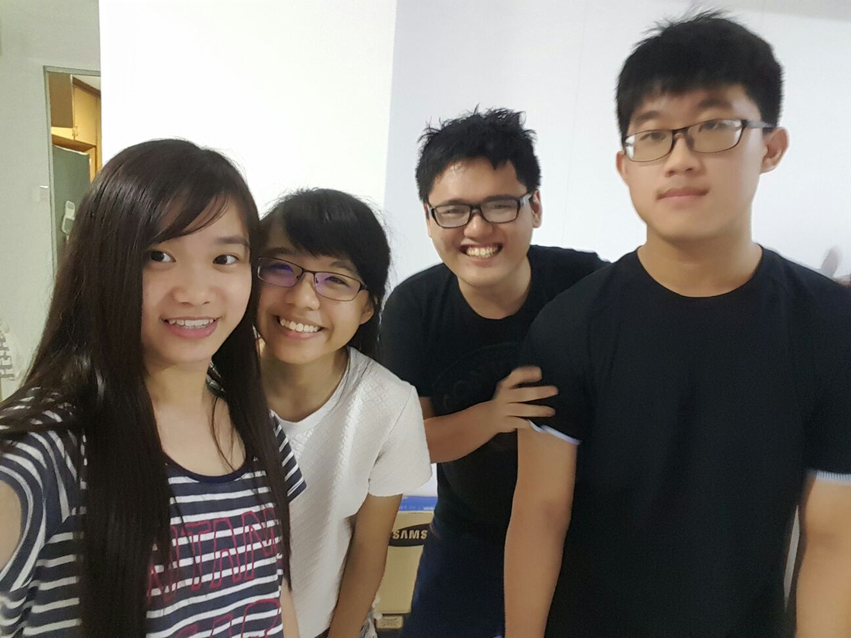
Pure Insanity
The Idea
My dashboard that I come up with will be motivation.
Interest level for motivated & unmotivated students
Measurement: It measures their interest level before coming to NYP, on semester 1 and semester 2 according to student's motivation.
Charts: Line Chart (To show the trends of their interest level which affect whether the student is motivated or unmotivated)
Reasons of motivated & unmotivated in SIT
Measurement: It measures the number of students who are motivated and unmotivated because of these reasons.
Charts: Pie Chart (To show different reasons)
How are the ideas generated
We sometimes think of some questions relating to this challenge and then we surveyed them through interview.
Using the results, we sort them out into different categories.
But for these, we will sort them out and think of the ideas of what the charts would be through re-defined challenge.
Through this, we had come out with this idea.
The Team
Team Members:
Tan Jun Long (151176T)
Aw Aun Yeow (152899E)
Chong Yan Qing (154466H)
Gan Wan Tian Mabel (151477X)

